Slide 1
IBM University Engagement Project Submission
“Exploring the Power of Agentic AI with IBM Granite and LangFlow”

Slide 2

Project Title – AI-Powered Personalized Learning & Teacher Assistant Platform
Domain of Project – Education
Student Name | Recent Passport Photo | Email ID | Mobile number
Sreeraj Nair |  | sreerajnair03@gmail.com | 9173800185

Slide 3
Problem Statement -AI-Powered Personalized Learning & Teacher Assistant Platform
The Challenge
Many government and rural schools in Gujarat face diverse student learning levels, limited personalized resources, increasing teacher workload, and inadequate real-time performance insights. Teachers need AI support to create lessons, assess students, and provide personalized learning assistance.
The Objective :
Personalized Learning – Recommend learning activities based on student performance.
AI Content Generation – Generate lesson plans, worksheets, and questions.
Assessment & Feedback – Evaluate answers and provide instant feedback.
Performance Analytics – Identify weak areas and students needing support.
Multi-Agent System – Use specialized agents for learning recommendations, content generation, assessment, analytics, and teacher assistance.
Learning Resources – Integrate IBM SkillsBuild and OER resources.
Teacher Dashboard – Provide student progress and actionable AI insights.

Slide 4
Proposed Solution - ShikshaFlow AI
An Agentic AI-powered education platform that connects teachers, classes, and students through personalized learning and intelligent classroom support.
The platform will:
Manage Teachers, Classes & Students – Provide role-based dashboards for managing classes, students, tasks, and progress.
Personalize Learning – Analyze student performance and recommend suitable topics, activities, and resources.
Assist Teachers – Generate lesson plans, worksheets, questions, and classroom activities using AI.
Automate Assessment – Evaluate student responses, identify mistakes, and provide instant feedback.
Analyze Performance – Track scores, attendance, task completion, and learning trends to identify weak areas.
Provide Student Support – Detect students requiring additional attention and suggest appropriate interventions.
Integrate Learning Resources – Recommend relevant IBM SkillsBuild and OER resources.
Use Agentic AI – Deploy specialized AI agents for content generation, assessment, analytics, personalization, and teacher assistance.

Slide 5
Technology Used
IBM Granite LLM – For natural language understanding, reasoning, content generation, and personalized learning recommendations.
IBM Cloud – Provides a secure, scalable, and reliable infrastructure for deploying the AI platform and services.
RAG (Retrieval-Augmented Generation) – Retrieves relevant learning information from trusted sources before generating AI responses.
IBM watsonx.ai – For AI model deployment, inference, and AI governance.
Vector Database (FAISS/Chroma) – Stores and retrieves embeddings of learning resources for RAG-based knowledge retrieval.
IBM SkillsBuild & OER – Provides educational resources and learning materials for students and teachers.

Slide 6
Langflow component Used
1) Chat Input – Interface where teachers or students enter their queries, requirements, or learning-related questions.
2) AI Agent – Processes user input and routes it to the appropriate specialized agent for personalized learning, content generation, assessment, feedback, or teacher assistance.
3) IBM Granite Model – Granite-3.2-8B-Instruct → Used for natural language understanding, reasoning, content generation, and personalized recommendations.
4) Chat Output – Displays AI-generated responses such as lesson plans, learning recommendations, assessment results, feedback, and student insights.
5) File/Data Component – Stores and retrieves student profiles, class data, tasks, submissions, performance records, and learning resources.
6) Prompt Template – Combines the user's request with relevant class, student, and performance context to generate accurate and personalized AI responses.
7) JSON Parser – Processes and validates structured AI outputs such as questions, scores, feedback, and recommendations before displaying them in the application.

Slide 7
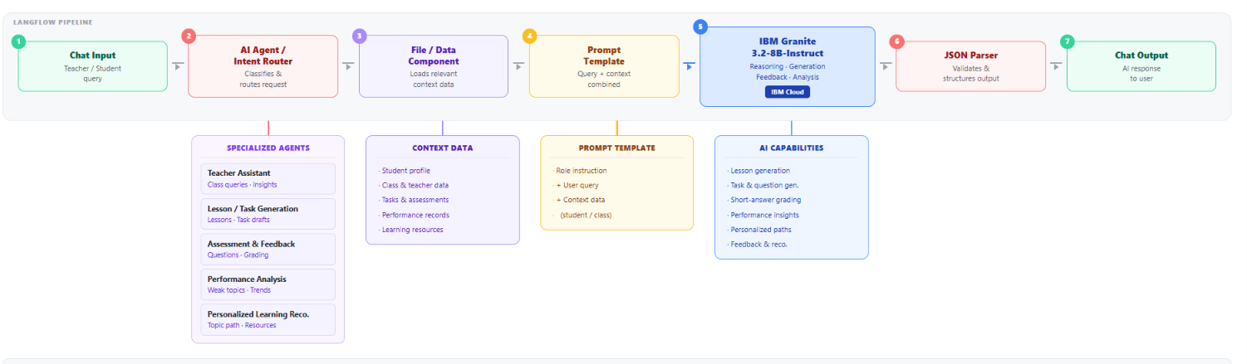
LangFlow workflow

Slide 8
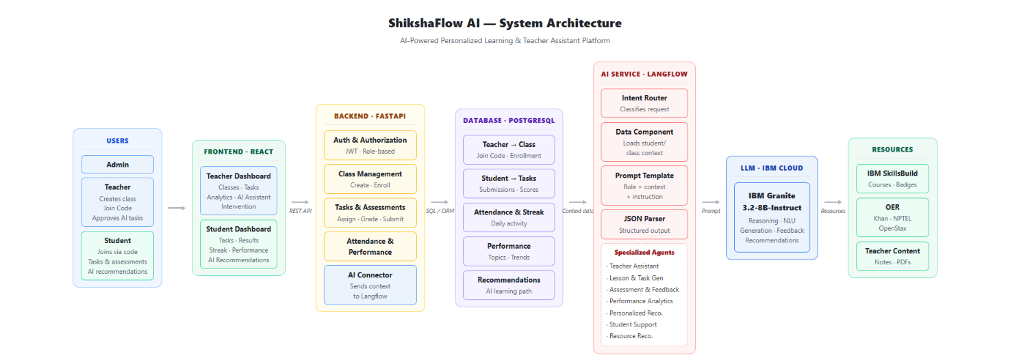
Architecture blueprint

Slide 9
Role of Agentic AI in the solution
Agentic AI enables ShikshaFlow AI to work as an intelligent, autonomous, and adaptive education system rather than a simple chatbot. Using Langflow, IBM watsonx.ai, IBM Granite, RAG, and IBM Cloud, multiple specialized agents collaborate to provide personalized learning and teacher assistance.
Each agent performs a specific role—such as content generation, student performance analysis, automated assessment, feedback, and personalized recommendations—through coordinated multi-agent workflows. The system uses context awareness by analyzing student profiles, class data, assessment history, and performance to generate relevant recommendations.
Agentic AI also provides autonomous decision-making and real-time adaptation, allowing recommendations and remedial activities to change as new student data becomes available. With Human-in-the-Loop (HITL), teachers can review and approve AI-generated content before it is assigned.
Overall, Agentic AI makes ShikshaFlow AI proactive, personalized, adaptive, and outcome-driven, acting as a smart digital teaching assistant for teachers and students.

Slide 10
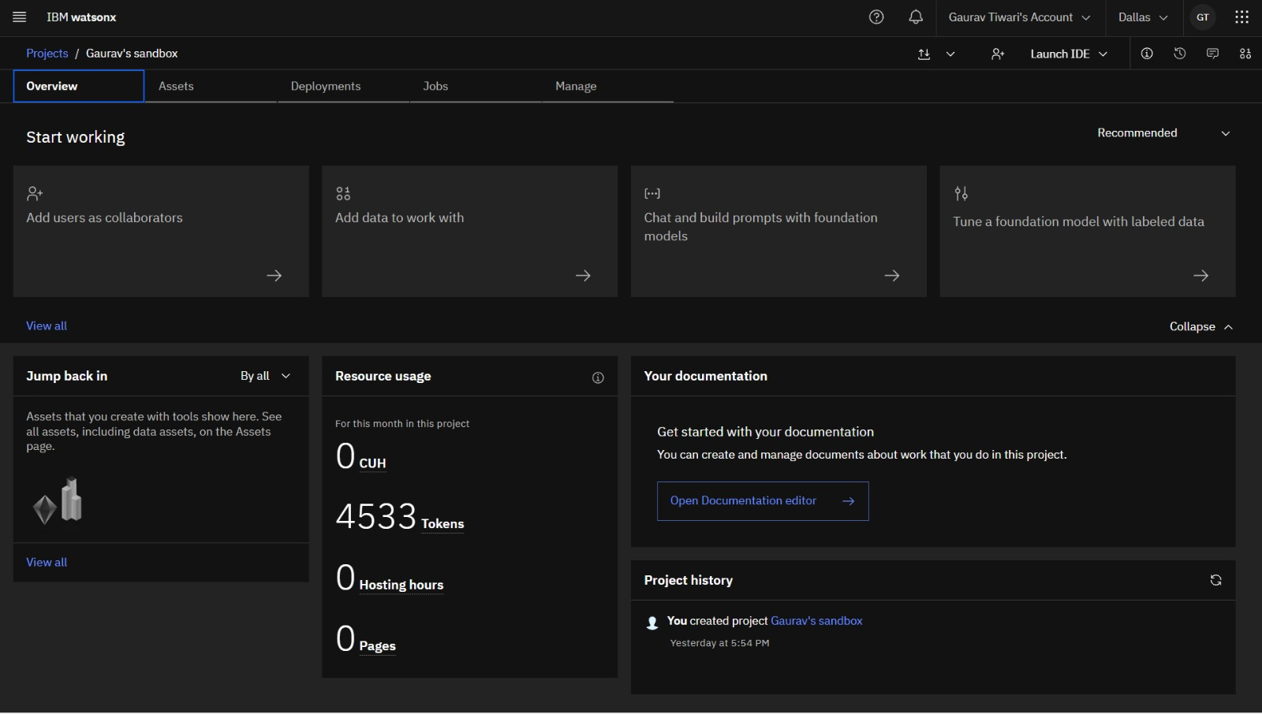
Token Usage
·
·
·

Slide 11
Novelty and Uniqueness
ShikshaFlow AI combines Agentic AI, personalization, real-time analytics, and teacher-in-the-loop learning into one intelligent platform.
Multi-Agent Intelligence – Specialized agents handle content generation, assessment, feedback, analytics, and personalized recommendations.
Context-Aware Learning – Uses student profiles and performance data to generate relevant learning support.
Adaptive Personalization – Continuously updates learning recommendations based on new assessment results.
Early Support Detection – Identifies weak areas and students needing remedial assistance.
Teacher-in-the-Loop – Teachers review and approve AI-generated content and interventions.
RAG-Based Resources – Retrieves relevant educational content from IBM SkillsBuild and OER.
IBM-Powered AI – Combines Langflow, IBM Granite, IBM watsonx.ai, and IBM Cloud for an intelligent and scalable architecture.

Slide 12
Git Hub Link
Github URL – https://github.com/SreerajNair305/ShikshaFlow-AI
·
·
·

Slide 13
Future Scope
Multilingual Learning – Support Gujarati, Hindi, and other regional languages.
Voice & Multimodal AI – Enable voice-based queries and image-based learning/assessment.
Advanced Personalization – Build deeper learner profiles using long-term learning patterns.
Predictive Analytics – Predict learning difficulties and identify at-risk students earlier.
Parent Dashboard – Provide parents with student progress and personalized insights.
Mobile Application – Extend ShikshaFlow AI to Android and low-connectivity environments.
Expanded RAG Knowledge Base – Integrate more OER, IBM SkillsBuild, textbooks, and curriculum resources.
Continuous AI Improvement – Use learning outcomes and feedback to improve recommendations over time.
·
·
·

Slide 14
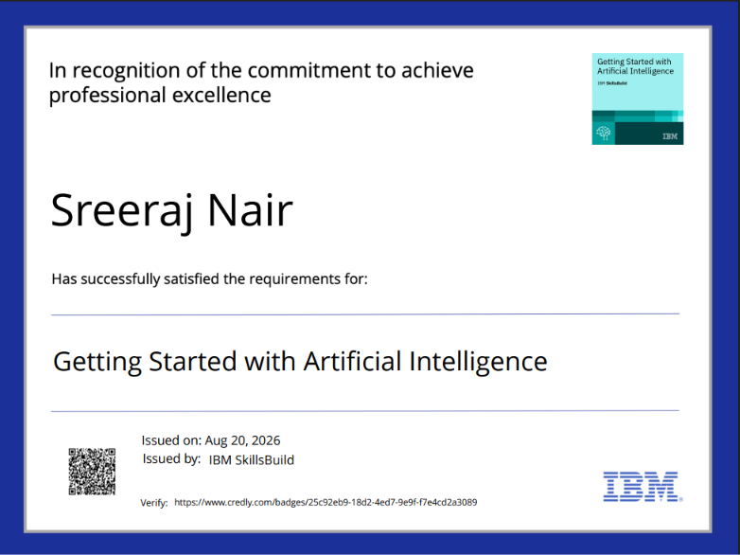
Certificates Earned:

Slide 15
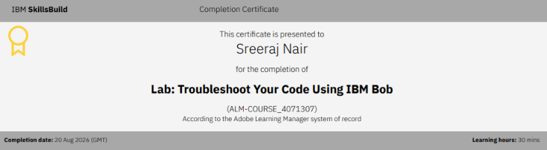
Certificates Earned:​

Slide 16


